Slide 1

CSCI 4502/5502
Data Mining - Fall 2023 - Lecture 15
Ravi Starzl, PhD

Slide 2
1
Basic Concepts
2
Partitioning Methods
Cluster Analysis
3
Hierarchical Methods
4
Density-based Methods
5
Grid-based Methods
6
Evaluation of Clustering
Ravi Starzl, PhD - Data Mining Fall 2023

Slide 3

Grid-Based Clustering
Uses multi-resolution grid data structure
Quantizes object space to cells in the grid
Fast processing time: depends on #cells, not #objects
Typical methods
STING: statistical info of grid cells
CLIQUE: high-dimensional data
Ravi Starzl, PhD - Data Mining Fall 2023
Notes:
Grid-based clustering is a technique that organizes data into a multi-resolution grid structure. This method involves partitioning the object space into distinct cells aligned within the grid.
One of the primary advantages of grid-based clustering is its efficiency. The processing speed is determined by the number of cells in the grid rather than the total number of data objects. This can lead to faster results when working with large datasets.
Among the methods utilized in grid-based clustering:
STING stands for "STatistical INformation Grid." In this approach, each cell in the grid contains statistical information about the data points it encloses. This statistical representation can then be used to identify clusters or patterns within the data.
CLIQUE is particularly suited for high-dimensional data. It identifies dense clusters in subspaces of the data's dimensionality. The method divides each dimension into intervals, forming cells in the multi-dimensional space, and then identifies regions where data points are densely populated.

Slide 4
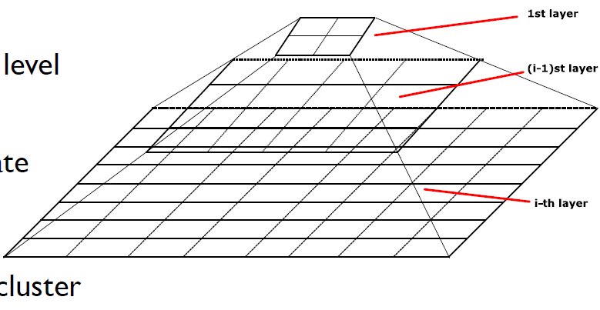
STatistical INformation Grid
Spatial area => rectangular cells,
multi-resolution
O(g): # grid cells at bottom level
Query-independent, easy to
parallelize, incremental update
Finer vs. coarser granularity
Only horizontal or vertical cluster boundaries, no diagonal boundaries
Ravi Starzl, PhD - Data Mining Fall 2023
Notes:
STING is a method that partitions a spatial area into rectangular cells, adhering to a multi-resolution framework. The computational complexity of STING is denoted as O(g), where g represents the number of grid cells at the most detailed level.
The method is query-independent, facilitating easy parallelization and allowing for incremental updates. When utilizing STING, the granularity of the grid can vary, with options for finer or coarser cell sizes. However, it's noteworthy that STING only recognizes horizontal or vertical cluster boundaries and does not account for diagonal boundaries.

Slide 5
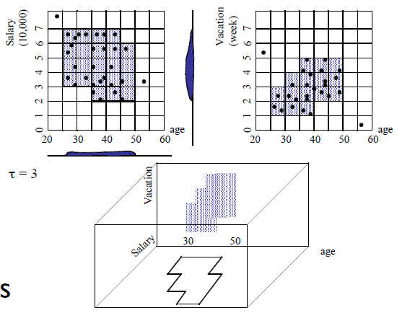
CLIQUE
Dimension-growth subspace clustering
grow from single dims to high dims
Both density-based and grid-based
each dim => equal-width intervals
non-overlapping rectangular units
cluster: a set of connected dense units
Ravi Starzl, PhD - Data Mining Fall 2023
Notes:
CLIQUE is a subspace clustering technique that emphasizes the growth of dimensions. It begins its process by clustering in single dimensions and systematically extends its operations to encompass higher-dimensional spaces. This method is a fusion of two clustering approaches: density-based and grid-based.
In the CLIQUE approach, every dimension is systematically segmented into intervals of equal width. This partitioning creates distinct, non-overlapping rectangular units in the data space. The primary objective of this method is to identify and group dense regions in the subspace. A cluster, within the context of CLIQUE, is characterized as a group of these dense units that are interconnected. This connectivity ensures that data points within a cluster are more similar to each other than to those outside the cluster.

Slide 6
1
Probabilistic model-based clustering
Advanced Cluster Analysis
2
Clustering high-dimensional data
3
Clustering graph and network data
4
Clustering with constraints
Ravi Starzl, PhD - Data Mining Fall 2023

Slide 7

Fuzzy Clusters
Cluster membership of each object
belongs to a single cluster
weighted distribution in multiple clusters
Fuzzy clusters (soft clusters)
n objects, k clusters
w_ij: probability of object i belonging to cluster j
0 <= w_ij <= 1
Ravi Starzl, PhD - Data Mining Fall 2023
Notes:
Fuzzy clustering is an approach that allows objects to be part of multiple clusters with varying degrees of membership. Unlike traditional clustering methods where each object is assigned to a single cluster, in fuzzy clustering, an object can have partial memberships in several clusters.
This method, also known as soft clustering, reflects the complexities of real-world data where boundaries between clusters are not always clear-cut.
For a dataset with n objects aiming to form k clusters, the relationship between an object and a cluster is determined by a weight, denoted as w_ij. This weight represents the likelihood of object i being in cluster j. The value of w_ij can range from 0 to 1. A value of 0 means the object does not belong to the cluster at all, while a value of 1 indicates full membership. Values between 0 and 1 represent varying degrees of membership, capturing the essence of the object's association with that cluster.

Slide 8
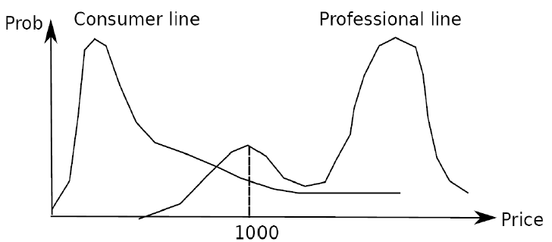
Probabilistic Clusters
Hidden categories (probabilistic clusters)
each represented by a probability density function over the data space
Mixture model: observed data instances drawn independently from multiple clusters
Ravi Starzl, PhD - Data Mining Fall 2023
Notes:
In probabilistic clustering, data points are grouped based on the likelihood that they belong to certain hidden categories. These hidden categories are termed as probabilistic clusters. Each probabilistic cluster is defined by its distinct probability density function that spans the entirety of the data space. This function provides a measure of how likely a data point belongs to that specific cluster.
The mixture model is a fundamental component of probabilistic clustering. It operates under the assumption that the data observed is a combination of instances drawn from various clusters. Each of these instances is drawn independently, suggesting that the presence of one data point in a cluster doesn't influence the presence of another in the same or different cluster. The overall goal of this clustering approach is to determine the underlying probability distribution for each cluster and, consequently, assign data points to clusters based on these distributions.

Slide 9
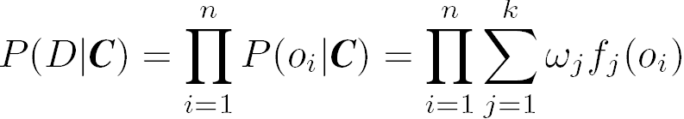
Model-Based Clustering
Assumption: Data are generated by a mixture of underlying probability distributions
Attempt to optimize the fit between data and some mathematical model
find a set C of k probabilistic clusters s.t. P(D|C) is maximized
Ravi Starzl, PhD - Data Mining Fall 2023
Notes:
Model-based clustering operates under the premise that the observed data is generated by a mixture of several underlying probability distributions. This approach seeks to find the best mathematical representation that captures the inherent structure and patterns within the data.
To achieve this, the methodology aims to discover a set (C ) of ( k) distinct probabilistic clusters. The optimization criterion is to maximize the conditional probability (P(D|C). Here, ( D) denotes the dataset, and (C) represents the identified clusters. The higher this conditional probability, the better the identified clusters represent the observed data.
In essence, model-based clustering provides a framework where the observed data is understood in terms of probabilistic models, and the clustering process seeks to refine these models to best fit the data's characteristics.

Slide 10
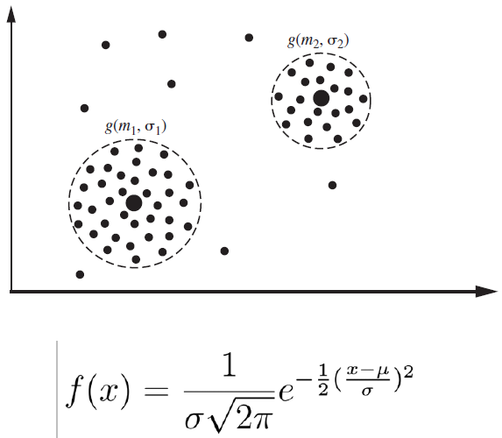
EM: Expectation Maximization
A popular iterative refinement algorithm
An extension to k-means
assign each object to a cluster according to a weight (probability distribution)
new means computed on weighted sum
Mixture of k distributions
distribution => cluster
e.g., Gaussian distr. θ_j = (μ_j, σ_j)
Ravi Starzl, PhD - Data Mining Fall 2023
Notes:
Expectation Maximization, commonly referred to as EM, is an iterative refinement algorithm. It serves as an extension to the k-means clustering method. Instead of assigning each object to a single cluster, EM allocates objects based on a weight, which is interpreted as a probability distribution. When computing new cluster centers, EM uses a weighted sum of the data points.
The EM algorithm operates on the premise of a mixture of (k) distributions, with each distribution corresponding to a specific cluster. For instance, in the context of a Gaussian distribution, the parameters (theta_j) for a given cluster (j) are given by its mean (mu_j) and standard deviation (sigma_j).

Slide 11
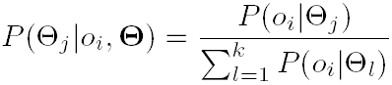
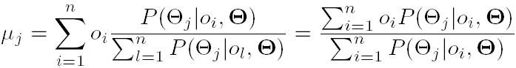
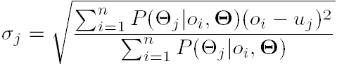
The EM Algorithm (1)
Expectation step (E-step)
Maximization step (M-step)
Ravi Starzl, PhD - Data Mining Fall 2023
Notes:
The Expectation Maximization (EM) Algorithm is a methodical process that involves two primary stages:
1. Expectation Step (E-step): At this juncture, the algorithm estimates the expected value based on the current parameters. It assesses how probable the data is, given the current model parameters.
2. Maximization Step (M-step): In this phase, the algorithm refines the model parameters to maximize the likelihood of the data observed in the E-step. This step involves updating the parameters to better fit the data based on the expectations formulated previously.
The EM algorithm repeatedly alternates between the E-step and the M-step. This iterative process continues until the changes in the parameters are negligible or another stopping criterion is satisfied, indicating that the model parameters have been optimized for the given data.

Slide 12

The EM Algorithm (2)
Simple, easy to implement
Can be characterized by a few parameters
Generally converges quickly but may not reach the global optima
Computationally expensive if number of distributions is large or data set contains very few observed data points
Ravi Starzl, PhD - Data Mining Fall 2023
Notes:
The Expectation Maximization (EM) Algorithm has several defining features:
1. Simplicity: The algorithm is straightforward and easy to implement.
2. Parametrization: The algorithm can be defined using a limited number of parameters.
3. Convergence: While the EM algorithm typically converges rapidly, it might settle at a local optima rather than the global optima.
4. Computation: The algorithm can be computationally demanding if it deals with a high number of distributions or if the dataset has a sparse number of observed data points.

Slide 13
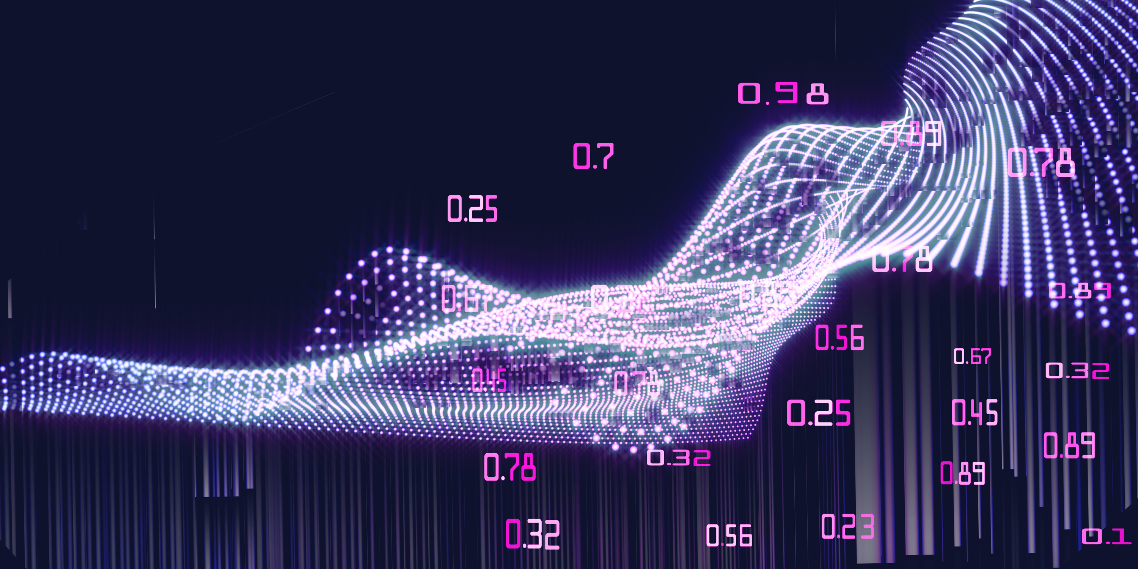
Clustering High-Dimensional Data
High-dimensional data
e.g., text documents, DNA micro-array data
Methods
subspace clustering, dimensionality reduction
Challenges
many irrelevant dimensions may mask clusters
distance measure dominated by noises
clusters may exist only in some subspaces
Ravi Starzl, PhD - Data Mining Fall 2023
Notes:
High-dimensional data refers to datasets with a large number of attributes or features. Examples of such data include text documents and DNA micro-array data.
To cluster high-dimensional data, methods like subspace clustering and dimensionality reduction are employed.
Clustering high-dimensional data presents several challenges:
1. The presence of numerous irrelevant dimensions can obscure the true clusters within the data.
2. The distance measures, used to determine similarity between data points, can be overwhelmed by noise.
3. Clusters might be present only in specific subspaces, making them harder to detect when considering the full dimensionality.

Slide 14

The Curse of Dimensionality
Data in only one dimension is relatively packed
Adding a dimension “stretch” the points across that dimension, making them further apart
Adding more dimensions will make the points further apart
high-dimensional data is extremely sparse
Distance measure becomes meaningless
due to equi-distance
Ravi Starzl, PhD - Data Mining Fall 2023
Notes:
When data exists in a single dimension, it tends to be relatively compact. However, as dimensions are added, the data points are "stretched" across each new dimension, increasing the distance between them. With the addition of more dimensions, this effect is amplified, leading to greater separation between data points.
In high-dimensional spaces, data tends to be sparse. This sparsity poses a challenge as traditional distance measures become less meaningful. Specifically, the phenomenon of equi-distance arises, where the distances between most pairs of points become nearly equal, diminishing the utility of distance-based metrics.

Slide 15
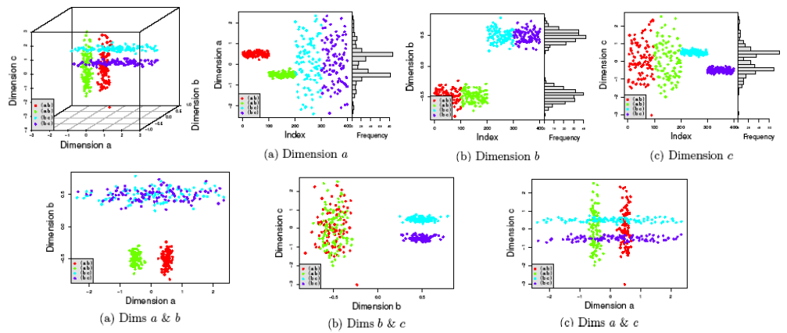
Why SubSpace Clustering?
Clusters may exist only in some subspaces
Subspace clustering: find clusters in all the subspaces
Ravi Starzl, PhD - Data Mining Fall 2023
Notes:
In high-dimensional datasets, the inherent structure or grouping of data points might not be apparent when considering all dimensions simultaneously. Some clusters might be discernible only when a subset of dimensions is examined. This phenomenon leads to the necessity of subspace clustering.
Subspace clustering is designed to address the challenges posed by high-dimensional data. Instead of attempting to find clusters using the full dimensionality, this approach focuses on identifying clusters in various subspaces of the dataset. Each subspace, being a subset of the total dimensions, can reveal clusters that are otherwise hidden or obscured in the full-dimensional space.
By systematically exploring different combinations of dimensions, subspace clustering can uncover meaningful clusters that traditional clustering methods might miss. This makes it especially valuable for datasets where the relevance of dimensions varies, and not all dimensions contribute equally to the formation of clusters.

Slide 16

Subspace Clustering
Dimension-growth: CLIQUE
Dimension-reduction: PROCLUS
mediods, subset of dimensions with small distance, k * L dimensions for k clusters
Frequent pattern-based clustering
frequent term-based document clustering
clustering by pattern similarity in micro-array data (pClustering)
Ravi Starzl, PhD - Data Mining Fall 2023
Notes:
Subspace clustering approaches can be broadly categorized based on their strategies:
1. Dimension-Growth Approach: An example of this is the CLIQUE algorithm, which starts with lower dimensions and systematically explores higher-dimensional subspaces to identify clusters.
2. Dimension-Reduction Approach: PROCLUS is a representative algorithm for this approach. It operates by selecting mediods and focusing on a subset of dimensions that exhibit small distances. For k) clusters, it considers (kxL) dimensions.
3. Frequent Pattern-Based Clustering: This method identifies clusters based on recurring patterns. In the context of text data, frequent term-based document clustering is employed. For biological data, such as micro-array data, clustering by pattern similarity is utilized, often referred to as pClustering.

Slide 17
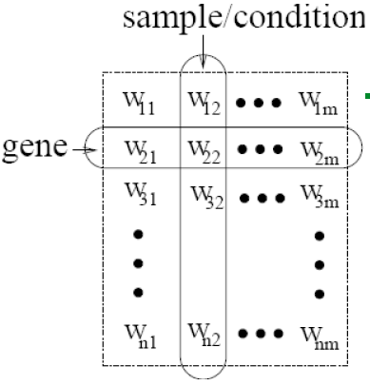
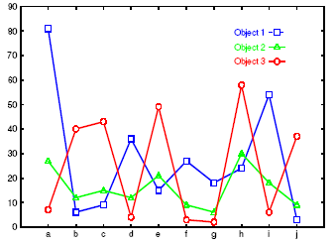
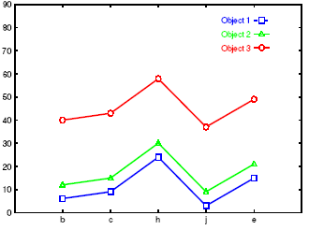
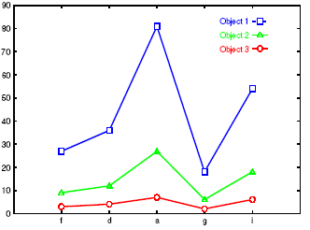
Bi-Clustering
Cluster both objects and attributes simultaneously
e.g., micro-array data analysis
e.g., customers and products
Ravi Starzl, PhD - Data Mining Fall 2023
Notes:
Bi-clustering, also known as co-clustering or two-mode clustering, is a specialized clustering technique that targets both rows (objects) and columns (attributes) of a data matrix simultaneously. The primary goal is to identify subsets of objects and attributes that exhibit similar behavior or patterns.
In contrast to traditional clustering, where only rows or columns are grouped, bi-clustering aims to find rectangular submatrices within the data matrix where the elements are coherent in some sense. This coherence might be based on absolute values, relative values, or statistical measures.
One prominent application of bi-clustering is in the field of genomics, particularly in micro-array data analysis. Here, bi-clustering can identify sets of genes and conditions where the genes exhibit similar expression patterns under the identified conditions. This can be crucial in understanding gene functionalities and their activation under specific circumstances.
Another application is in market research. In scenarios where data matrices represent customers and products, bi-clustering can reveal subsets of customers with similar purchasing behaviors for specific groups of products. Such insights can be instrumental for targeted marketing, product placement, or inventory management.

Slide 18

Clustering Graphs
Applications
bi-partite graphs: customers and products, authors and conferences
web search engines: web graphs, click through graphs
social networks, friendship/coauthor graphs
Graph clustering methods
generic clustering or graph specific (e.g., minimum cuts, density based)
Ravi Starzl, PhD - Data Mining Fall 2023
Notes:
Clustering graphs is a technique employed to group nodes in a graph based on specific criteria or relationships.
Applications:
- Bi-partite graphs: These are graphs where the sets of nodes can be divided into two distinct groups, such as customers and products or authors and conferences.
- Web search engines: Graph-based representations like web graphs or click-through graphs play a role in understanding user behavior and optimizing search results.
- Social networks: Graphs in this context represent entities like users, with edges indicating relationships or interactions. Examples include friendship graphs or coauthor graphs in academic networks.
Graph Clustering Methods:
Graph clustering can be approached using generic clustering techniques or methods tailored specifically for graphs. Some graph-specific methods include strategies based on minimum cuts or density-based clustering.

Slide 19
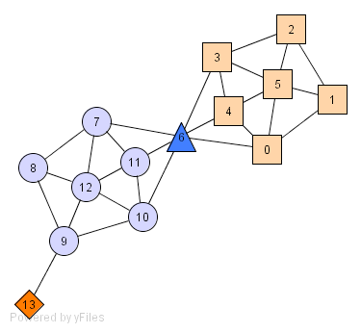
Density-based Graph Clustering
Structure-connected cluster C
connectivity, maximality
Hubs
not belong to any cluster
bridge to many clusters
Outliers
connect to few clusters
Ravi Starzl, PhD - Data Mining Fall 2023
Notes:
Density-based graph clustering categorizes nodes in a graph by emphasizing regions where nodes are densely interconnected.
1. Structure-connected cluster (C): This is a dense region in the graph where nodes are closely interconnected. The principle of connectivity ensures that any two nodes within the cluster can be reached through a series of interlinked nodes. Maximality ensures that the cluster cannot be expanded further by including adjacent nodes without compromising its dense nature.
2. Hubs: Hubs play a unique role in graph structures. While they may not be integral to any single dense cluster, they provide significant connectivity across the graph. Their function is to act as intermediaries or bridges, ensuring communication or linkage between multiple clusters.
3. Outliers: In contrast to hubs and nodes within clusters, outliers stand somewhat isolated. Their defining characteristic is a minimal number of connections, making them less integrated into the graph's dense regions. These nodes might be peripheral or might represent anomalies or special cases in the dataset.

Slide 20

Categorization of Constraints (1)
Constraints on individual objects
cluster houses worth over $300K
Constraints on the selection of clustering parameters
#clusters, MinPts, etc.
Constraints on distance or similarity function
weighted functions
obstacles (e.g., river, lake)
Ravi Starzl, PhD - Data Mining Fall 2023
Notes:
Constraints in clustering can be classified into three main types:
1. Constraints on Individual Objects: These constraints pertain to specific attributes or properties of the data objects. An example would be clustering houses that have a value exceeding $300K.
2. Constraints on Clustering Parameters: These constraints relate to the parameters that define the clustering process, such as the number of clusters or parameters like MinPts.
3. Constraints on Distance or Similarity Function: These constraints modify or define how distances or similarities between data objects are calculated. This category includes the use of weighted functions or the incorporation of real-world barriers like rivers or lakes that may affect clustering.

Slide 21

Categorization of Constraints (2)
User-specific constraints on the properties of individual clusters
contain at least 500 valued customers and 5000 ordinary ones
Semi-supervised clustering based on “partial” supervision
pairs of objects labeled as belonging to the same or different clusters
Ravi Starzl, PhD - Data Mining Fall 2023
Notes:
Categorization of Constraints: Further Classifications
1. User-Specific Constraints on Cluster Properties: These constraints are determined based on specific requirements related to the characteristics of individual clusters. An example includes defining a cluster to contain a minimum of 500 valued customers and 5,000 ordinary ones.
2. Semi-Supervised Clustering with Partial Supervision: This approach incorporates some prior knowledge into the clustering process. It involves using pairs of objects that are pre-labeled to either belong to the same cluster or different clusters. This pre-labeling guides the clustering algorithm in its grouping decisions.

Slide 22
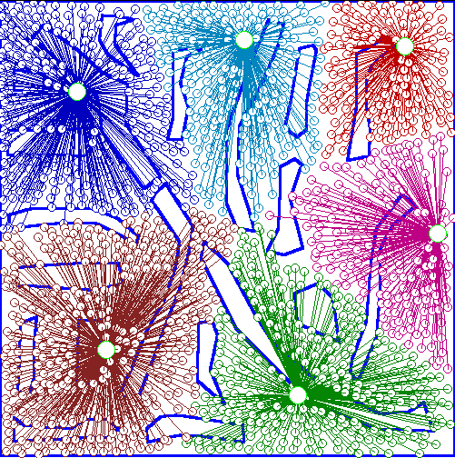
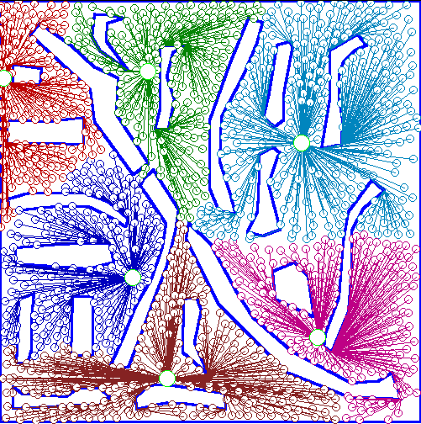
Clustering
w/ Obstacle Objs
Ravi Starzl, PhD - Data Mining Fall 2023
Notes:
Clustering with Obstacle Objects: Detailed Overview
Clustering aims to group data points based on their similarities or inherent patterns. However, when the data space contains obstacle objects, the standard clustering process can be affected. Obstacle objects are entities or regions that create barriers or separations in the data space, influencing the formation of clusters.
1. Nature of Obstacle Objects:
Physical Obstacles: These are tangible barriers within the data space. For instance, in geographical data, mountains, rivers, or lakes can act as physical obstacles affecting the clustering of cities or towns.
Abstract Obstacles: These are intangible barriers that might arise from the data's nature or the domain's constraints. For example, in a telecommunications dataset, regions with no signal coverage can act as abstract obstacles.
2. Implications for Clustering:
Cluster Separation: Obstacle objects can result in clear demarcations between clusters. Data points on either side of an obstacle might be closer in terms of raw distance but are separated due to the barrier.
Cluster Shape Alteration: The presence of obstacles can cause clusters to take on irregular or elongated shapes as they navigate around the barriers.
3. Strategies for Handling Obstacles:
Modifying Distance Measures: One approach is to adjust the distance metric to account for obstacles, effectively increasing the distance between points separated by a barrier.
Preprocessing: Before clustering, the data space can be preprocessed to mark or tag regions occupied by obstacles. Clustering algorithms can then be adapted to avoid or give less preference to these tagged regions.
Postprocessing: After obtaining initial clusters, a postprocessing step can refine the clusters by considering the obstacle objects, splitting or adjusting clusters as necessary.
Incorporating the understanding and handling of obstacle objects is vital for certain domains, ensuring that the clustering results align with the real-world implications of the data.

Slide 23
Cluster Analysis
Grid-based Methods
Evaluation of Clustering
Advanced Cluster Analysis
probabilistic model-based clustering
clustering high-dimensional data
clustering graph and network data
clustering with constraints
Summary
Ravi Starzl, PhD - Data Mining Fall 2023

Slide 24
Thank you
A special thank you to Qin Lv for her slides, on which this lecture is based
Ravi Starzl, PhD - Data Mining Fall 2023

